Slide 1

A Framework for Benevolent Computer Worms
Rodney Beede University of Colorado 19 April 2012

Slide 2
Agenda
Objective of Research
Worms
Traditional Methods
Why a benevolent worm?
Out of control? (section)
Related Work
Research Questions
Contribution of Research
Ethical Implications
Legal Implications
Analysis of Worm Characteristics
Summary of malicious worms
Desired Characteristics of a Benevolent Worm
Framework Design Details
Evaluation of framework implementation
Results
Concluding Remarks
Future work
Q&A

Slide 3
Objective of Research
Define characteristics
For Benevolent Worms
Develop framework
Supporting characteristics
Test framework
Auditable
Resource Friendly
Reduce perceived risks
Explore legal & ethics
Demonstrate feasibility

Slide 4
Worms
Concept since 1949
von Neumann
Self-replicating computer program
Intent
Mostly malicious
File deletion, credentials theft, etc.
Replication
Few well meaning (benevolence)
Explored later

Slide 5
Traditional Methods
Propagation
Network service vulnerabilities
E-mail attachments
Floppy disks
Stopping
Anti-virus
Firewalls
Patching vulnerabilities

Slide 6
Why a benevolent worm?
Opinion before 2011
Too risky
Crash hospital or nuclear plant?
Unethical
No consent
Bruce Schneier
Opinion 2011+
Benefits to community outweigh risks
Bruce Schneier
Need next generation technology
Ex: Kelihos botnet
Microsoft & Kaspersky
Too risky to patch victims
Unpatched used again later

Slide 7
Related Work
Henri J. Isenberg of Symantec Corporation
Patent author: “A Benevolent Worm To Assess And Correct Computer Security Vulnerabilities”
Tied to central anti-virus server
Notified user via GUI if made repairs
No specifics on framework or resource controls
“A Taxonomy of Computer Worms” (2003)
Nicholas Weaver of UC Berkeley
Strategies of malicious worms

Slide 8
Research Questions
What are the possible risks with releasing a benevolent worm into the wild?
What are the benefits?
What characteristics would a benevolent worm need to mitigate or reduce the risks of the benevolent worm causing more harm than good?
What would a framework for a responsible benevolent worm be?

Slide 9
Contribution of Research
Framework Details
Auditable (log)
Congestion Control (network)
Feasibility
Actual tests of worm

Slide 10
Ethical Implications
Who is responsible?
Bank or victim?
Cyber warfare
Civilians
Hospital system infected
Point of view
Stuxnet in Iran
Consent
Schneier 2003
Benefit to whole
Schneier 2011
Great Firewall of China

Slide 11
Legal Implications
Unprecedented
Official sanction anyway
Uncertainty
If something goes wrong sued?
Coreflood
U.S. Govt takedown
Record all IPs and take control (with consent)
Schneier: “it's the obvious solution for botnets.”
Limits of power? RIAA, FBI, etc.
Where does it stop?

Slide 12
Legal (continued)
Responsibility on ISP
Regulation by govt unwanted
Burden on smaller ISPs
Self-regulated industry
ISP monitors and disconnects
Privacy?
Implicit consent?
Legal notice on system attacked (DDoS)
If “zombie” vulnerable then patch

Slide 13
Analysis of Worm Characteristics
Key Questions
What was the worm’s purpose (benevolent or malicious)?
What methods of propagation were used?
Did the worm achieve its purpose?
What worked correctly?
What went wrong?
What could be corrected?

Slide 14
Nachi
Benevolent
Not sanctioned
Purpose: Remove Lovsan worm
Used same exploit
Did cleanse infected machines
Problem: Caused network congestion
Diebold ATMs IPS tripped
Manual fix required

Slide 15
Conficker
Malicious
Steals login credentials on Windows OS
Spread over network
Exploited Windows RPC service
Supported UPnP on routers
Payload
Locked accounts with excessive attempts
Disabled anti-virus & OS updates
Modified DNS to block updates
Problem: Too aggressive with accounts

Slide 16
Slammer
Purpose: Unknown
No payload (not even via download)
DoS on Internet?
Test how fast it could spread?
Exploited MS SQL Server overflow
Not practice to firewall then
55 million / second targets scanned
404 byte UDP packet
Problems
Bandwidth restrained
Network congestion

Slide 17
Storm
Malicious
Joins victims to botnet
Attachment in e-mail
Recent news headlines
Utilized P2P
Payload downloads
Hard to firewall or disable
1 of 3 rolls for infected host
Control server
Spreader
Standby
Conserved resources
CPU & memory
DoS to opposition
Anti-spam relay services
Purpose:
Sold to others?

Slide 18
Witty
Malicious
Infects security devices
ICQ Server traffic exploit
Buffer overflow in monitoring
Payload:
Wiped random areas of disk
Harder to analyze
Harder to filter
Random sized packets
Peak
90 Gbits per second of traffic
12,000 infections
Problems
Damaged host when rebooted crashed
Possibly on purpose though

Slide 19
Summary of malicious worms
Autonomous replication
Stealth
Few have slow scan
Hides on disk
Mutates or encrypts binary
Centralized & decentralized
Payloads
Disable anti-virus, OS updates
Standby for orders
Delete data
Steal data, credentials
DoS

Slide 20
Desired Characteristics of a Benevolent Worm
Semi-autonomous replication
Notify end-user or admin
Auto-terminate
Kill signal and crash detection
Resource preservation
Avoid network congestion
CPU, memory, disk
Control mechanism
Decentralized
Firewalls, routes, etc

Slide 21
Desired Characteristics (continued)
Verifiable
Signed code
Auditable
Log all actions
Log any crashes seen
Timestamp in UTC
Also relative to source
Short history of traversal

Slide 22
Desired Characteristics (continued)
Notification
Display user with cancel
Notify after run
Don’t avoid anti-virus/IDS
Revertible
Simple undo

Slide 23
Auditable
Log
For IT or knowledgeable
Permissions to modify
Limited to admin if possible
Log Tampering
Malicious person or program
Difficult to stop

Slide 24
Auditable – Log Tampering
Tampering solutions:
Send network signal
More congestion
Could be faked
Digitally sign
Key could be stripped out
Cat and mouse
If benevolent gets “kernel”
Could stop malicious only at administrator
Unless malicious has it first
Depends on who gets there first
Some external verification needed

Slide 25
Auditable – Log Tampering Solutions
Divide into tree
Worst case = verify each one
?

Slide 26
Auditable - Verifiable
ASSERT(statement was executed as claimed)
Inspect registry, maybe even scan binaries
ASSERT(statement N+1 occurred after statement N for all N)
ASSERT(there were no intervening statements that could undo any of the previous assertions)
i.e. The user or a malicious program didn’t uninstall an installed update

Slide 27
Auditable – Log Format
Standardized time stamp
ISO 8601:2004
UTC
Avoids DST & time zone issues
YYYY-MM-DDThh:mm:ss,fffZ
2012-02-20T14:51:22,98Z
UTF8
Supports non-English systems
<ISO 8601 timestamp><single tab><message><carriage return><new line>

Slide 28
Network Congestion Control
Linear rate of spread
Hop-to-hop
Slower than exponential
Less impact to network
Demonstrated later
Disadvantages
Node in hop dies/reboots/disconnects
Keep-alive from previous hops
Network partition issues
Alternative - Central node
May be blocked by firewalls, routes, etc
Easier to stop spread of worm

Slide 29
Alternative Hybrid Spread
Local network
Fan-out in exponential + linear fashion
First node starts 10 linear lines
Equal target list division
Non-local network
Fan-in for single linear line
Preserves WAN bandwidth

Slide 30
Semi-autonomous Replication
Allow local network only
Run by network admin
Specific targets/subnet
Kill switch
Listen for broadcast/P2P packet
Could be abused
Signed command only
Majority quorum
Useful if X crashes seen

Slide 31
Notification
GUI pop-up
Cancel button or Go Ahead
Auto-timer for Go Ahead
Admin can force go ahead
URL with information
Network message
Sent to network admin

Slide 32
Undo
Easy GUI icon or CLI command
Logs all actions for undo
Gives back sense of control
Fixes mistakes
Possibly via second version of worm

Slide 33
Other Considerations
CPU
Lower priority to process
Worm may be too slow, that’s okay
Memory
Terminate if low
Disk
Sufficient for log & worm

Slide 34
Exploit Selection
Biggest risk
Buffer overflow = overwriting memory
3 Possibilities:
The exploit does nothing (the system was patched, firewalled, or not vulnerable)
The exploit successfully executes on the target and the benevolent worm code executes
The exploit causes the target to crash

Slide 35
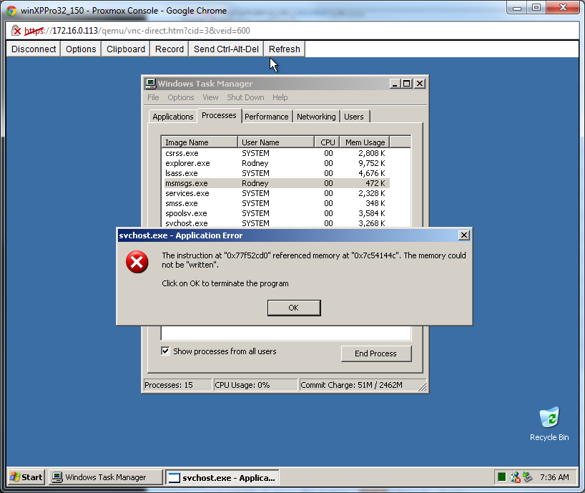
Exploit Research
MS03-026
Exploit Database – 1st version

Slide 36
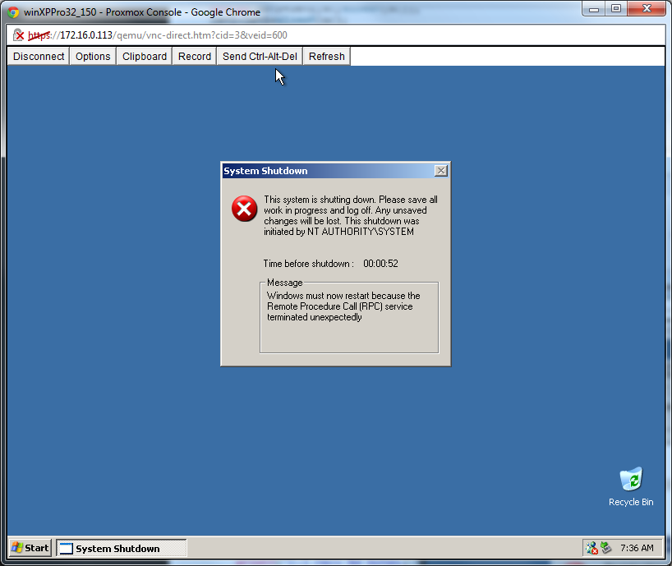

Slide 37
Exploit Maturity
First versions
Tend to be crash
Subsequent versions
More refined
Handle memory addresses
Different versions of OS
Need lots of testing
Virtualization labs help
Fingerprinting helps

Slide 38
Chosen Exploit
Metasploit Framework
Ruby version well developed
Utilizes libraries for RPC
Payload
Remote uploader
Port 65534
Copies larger worm binaries
Copies OS patch
Versus official WUS download

Slide 39
Evaluation of framework implementation
Written in C++
Larger than C/assembly
Smaller than Java
Avoids mistakes of buffer overflow
Benevolent worm can’t create vulnerability
Statically compiled

Slide 40
Test Environment
Virtual lab (34 total)
26 XP Pro SP0, 32-bit (vuln)
2 XP SP1, 64-bit
1 Vista Business with SP1, 32-bit
1 Vista Business with SP1, 64-bit
1 Win 7 Professional SP0, 32-bit
1 Win 7 Professional SP0, 64-bit
1 Server 2003 Standard SP0, 32-bit (vuln)
1 Server 2003 Standard SP0, 64-bit
38 target IPs
4 non-existent for testing

Slide 41
Execution Flow
Seed VM runs worm code
Worm logs configuration and options
Worm attempts to exploit the first target IP in the provided list
If successful
worm copies itself and runs on exploited target
If not successful
worm tries next target IP in the provided list
Once worm has successful exploit it ends execution on the current host
Worm runs on new (successfully exploited) target host (no longer the seed)
Worm logs configuration and options
Target list is now shorter since previous targets have been removed
Worm runs OS update patch
While target list isn't empty the worm attempts to exploit the next target IP in the list
If successful worm hops to next machine and ends
If unsuccessful worm tries the next target IP in the list

Slide 42
Example Worm Config
Research_Options_File.txt:
192.168.0.2 The previous hop 2012-03-23T14:50:37,537Z The prev hop timestamp 192.168.0.2 The seed IP or ID 192.168.0.150 First target IP 192.168.0.151 Second target IP 192.168.0.152 etc. 192.168.0.153 etc.
… (continues all the way to 187 for a total of 38 target IPs)

Slide 43
Test Steps
Revert all test VMs
Start worm execution from seed VM
Collect logs
Verify non-vulnerable VMs didn’t crash
Reboot exploited VMs
Finishes OS patch install
Test exploit again
Verify expected number of patched

Slide 44
Results
Table 1: First Iteration
Total Targets (existent and non-existent) | 38
Total Existent Targets | 34
Expected Exploitable | 27
Actual Exploited | 15
Expected Patched by Worm | 26
Actual Patched by Worm | 15
Expected Unaffected | 7
Actual Unaffected | 19
Actual Crash | 0
Run Time (min:sec) | 15:14
About 45% not exploited
Responsiveness of target

Slide 45
Results – Iteration 3
Table 3: Third Iteration
Total Targets (existent and non-existent) | 38
Total Existent Targets | 34
Expected Exploitable | 27
Actual Exploited | 13
Expected Patched by Worm | 26
Actual Patched by Worm | 12
Expected Unaffected | 7
Actual Unaffected | 21
Actual Crash | 0
Run Time (min:sec) | 13:48
Similar to iterations 1 & 2

Slide 46
Results – Network Congestion
Most Bytes Transmitted
In one instance
2,811,634
Bulk in worm & OS patch
100mbps switch
22.5% of bandwidth between 2 nodes
About 1 second
No significant impact

Slide 47
Results – Network Congestion (cont)
10mbps link
2.25 seconds to send
More significant impact
Not likely on local network
Exponential spread
Multiple 48-port 100mbps switches
1 gigabit / second channel
Congestion at 40+ sending nodes
Example on next slide

Slide 48
Results – Exponential Congestion
Single 48-port switch spread
1 -> 2
2 -> 4
4 -> 8
… … … … …
8 -> 16
…
16 -> 32
Assume all local until 16 -> 32 with 32 on other switch

Slide 49
Results - Exponential Congestion (cont)
Switch # 1
Targeting 32 nodes on Switch # 3
1 gbps link
Switch # 2
Targeting 32 nodes on Switch # 4
Congestion occurs here
1 gbps link
Switch # 3
Targeting nothing currently
1 gbps link
Switch # 4
Targeting nothing currently

Slide 50
Concluding Remarks
Benevolent worm feasible = YES
Auditable (log)
Resource control (network)
Still has risks
Crashes
Legal precedent
Benefits
Safer Internet

Slide 51
Future Work
Log authenticity
Replication
Redundancy
Hybrid linear/exponential
What fan-out is useful?
UI research
Help users versus scare
Scaring could be beneficial

Slide 52
References
Please see thesis paper: “A Framework for Benevolent Computer Worms” by Rodney Beede, 2012
PowerPoint template care of http://www.powerpointstyles.com

